Slide 1
DOMESTIC WASTE MANAGEMENT
PIP2001 Capstone Project
Review-1
Batch Number: CSE-200
Roll Number | Student Name
20211CSE0196 20211CSE0230 20211CSE0550 20211CSE0140 | Eshaan Khurana Charan Kumar S Gagana Sindhu B M Hisham
Under the Supervision of,
Dr. Chandra Sekhar M
Professor
School of Computer Science and Engineering
Presidency University
Name of the Program: B.Tech
Name of the HoD: Dr. Asif Mohamed H B
Name of the Program Project Coordinator:
Name of the School Project Coordinators: Dr. Sampath A K / Dr. Abdul Khadar A / Mr. Md Ziaur Rahman

Slide 2
Introduction
Domestic waste management has emerged as a crucial environmental issue due to the increasing volume of waste generated by households. Effective management strategies are necessary to minimize environmental pollution, promote recycling, and ensure sustainability. This literature review explores various studies on domestic waste management, focusing on waste generation, collection, treatment, and disposal practices.

Slide 3
Literature Review
Recent Studies:
– IoT-based waste tracking: Smart bins & optimized collection (Rodriguez et al.,2024).
– AI-powered waste segregation: Automation in sorting systems (Kumar & Sharma,2023).
– Impact of public awareness campaigns on waste reduction (Gupta & Mohan,
2024).
• Hyderabad Waste Management Project (HWMP):
– Integrated Hazardous Waste Management: HWMP, a subsidiary of Re
Sustainability Limited, operates a Treatment, Storage, and Disposal Facility
(TSDF) established in 2001 in Medchal-Malkajgiri, Telangana
(hwmp.resustainability.com).

Slide 4
Existing method Drawback
Inefficient Waste Segregation: A lack of public awareness and improper segregation at the source reduces the efficiency of recycling programs (Singh et al., 2021).
Inadequate Collection Infrastructure: Many urban and rural areas face inconsistent waste collection services, leading to illegal dumping and environmental pollution (Zhang et al., 2022).
Overreliance on Landfills: The excessive use of landfills leads to soil and water contamination, as well as increased methane emissions contributing to climate change (Chen et al., 2020).
High Cost of Advanced Technologies: Waste-to-energy and other innovative treatment methods require significant investment, making them less accessible to developing regions (Müller & Heinrich, 2019).

Slide 5
Proposed Method
Enhanced Waste Segregation at Source: Implementing community awareness programs.
To evaluate domestic waste composition and trends.
To identify inefficiencies in existing waste disposal methods.
To propose a smart, data-driven waste management model.
To promote a healthy and sustainable means of waste disposal by the concept
of gamification.

Slide 6
Objectives
To analyze the composition and volume of domestic waste generated in various regions.
To propose a sustainable and efficient methodology for improving domestic waste management.
To explore policy frameworks and regulatory measures that can enhance waste management practices.

Slide 7
Methodology/Modules
Waste Segregation Module: Encourages source-level segregation by providing educational programs and necessary infrastructure, such as labeled bins for organic, recyclable, and non-recyclable waste.
Smart Collection Module: Integrates IoT-enabled smart bins, real-time tracking of waste collection vehicles, and an optimized scheduling system to ensure timely and efficient waste collection.
Recycling and Composting Module: Implements AI-driven waste sorting systems and decentralized composting units to maximize resource recovery and reduce landfill waste.

Slide 8
Hardware/software components
Python,Html/CSS
Cloud Storage

Slide 9
Timeline of Project
A structured timeline is essential for efficient project execution. The
implementation phases include:
Phase 0: Research and requirement gathering
Phase 1: System design and architecture planning
Phase 2: Development and testing of smart collection modules
Phase 3: Deployment and performance evaluation

Slide 10
Expected Outcomes
Improved waste segregation at the source, leading to higher recycling rates and reduced landfill dependency.
Enhanced efficiency of waste collection through IoT-enabled tracking and optimized routes.
Increased adoption of sustainable waste treatment methods, such as composting and waste-to-energy conversion.
Reduced environmental pollution and greenhouse gas emissions through better landfill management.

Slide 11
Conclusion
Effective domestic waste management is essential for environmental sustainability and public health. A multi-faceted approach involving waste reduction, recycling, policy interventions, and community participation is necessary to address existing challenges. Continued research and innovation will play a key role in shaping sustainable waste management practices worldwide.

Slide 12
Github Link
The Github link provided should have public access permission.
Github Link
https://github.com/Delhiwala/Domestic-Waste-Management

Slide 13
References
Brown, T., et al. (2018). "Recycling behavior and its impact on waste management."
Chen, L., et al. (2020). "Environmental impacts of landfill waste disposal."
Gupta, R., & Mohan, K. (2019). "Household waste composition and its management challenges."
Kumar, S., & Sharma, P. (2021). "Technological advancements in waste treatment."
Müller, J., & Heinrich, S. (2019). "Waste-to-energy technologies: An overview."

Slide 14
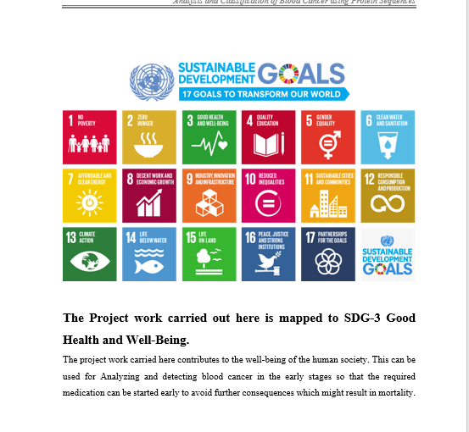
Project work mapping with SDG

Slide 15
Thank You

